Slide 1
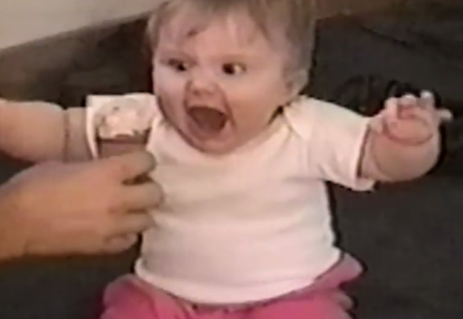
Ice Cream!
Regression Analysis
What are the possible factors that influence ice cream consumption? Can we predict consumption?

Slide 2

The Data
Ice cream consumption (cons, pints per person) was measured over 30 four-week periods from March 1951 to July 1953.
It is thought that variables influencing consumption may include:
the weekly family income (inc, $)
the mean monthly temperature (temp, °F)
Can you build a model that predicts consumption based on given data?

Slide 3
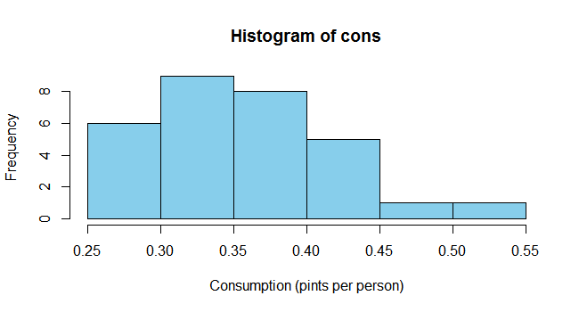
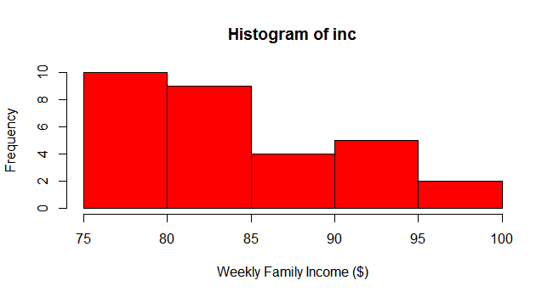
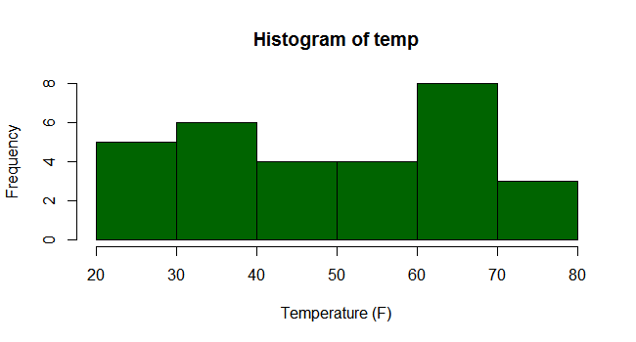
cons | inc | temp
0.386 | 78 | 41
0.374 | 79 | 56
0.393 | 81 | 63
0.425 | 80 | 68
0.406 | 76 | 69
0.344 | 78 | 65
0.327 | 82 | 61
0.288 | 79 | 47
0.269 | 76 | 32
0.256 | 79 | 24
0.286 | 82 | 28
0.298 | 85 | 26
0.329 | 86 | 32
0.318 | 83 | 40
0.381 | 84 | 55
0.381 | 82 | 63
0.47 | 80 | 72
0.443 | 78 | 72
0.386 | 84 | 67
0.342 | 86 | 60
0.319 | 85 | 44
0.307 | 87 | 40
0.284 | 94 | 32
0.326 | 92 | 27
0.309 | 95 | 28
0.359 | 96 | 33
0.376 | 94 | 41
0.416 | 96 | 52
0.437 | 91 | 64
0.548 | 90 | 71
Visualizing

Slide 4
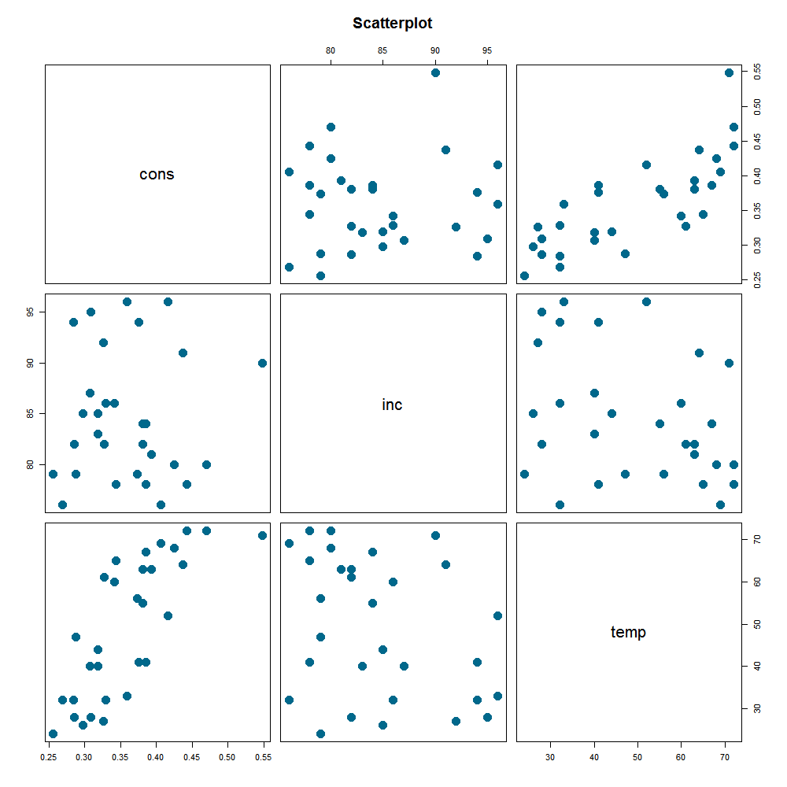
Correlation | inc | temp
cons | 0.048 | 0.78
Relationships

Slide 5
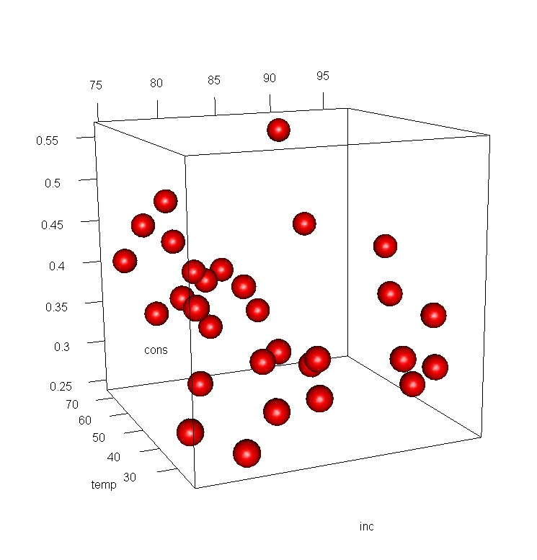
Relationships

Slide 6

Analysis
$$y=a+bx_{1}+cx_{2}$$
$$cons=−0.1132+(0.0035×inc)+(0.00354×temp)$$

Slide 7
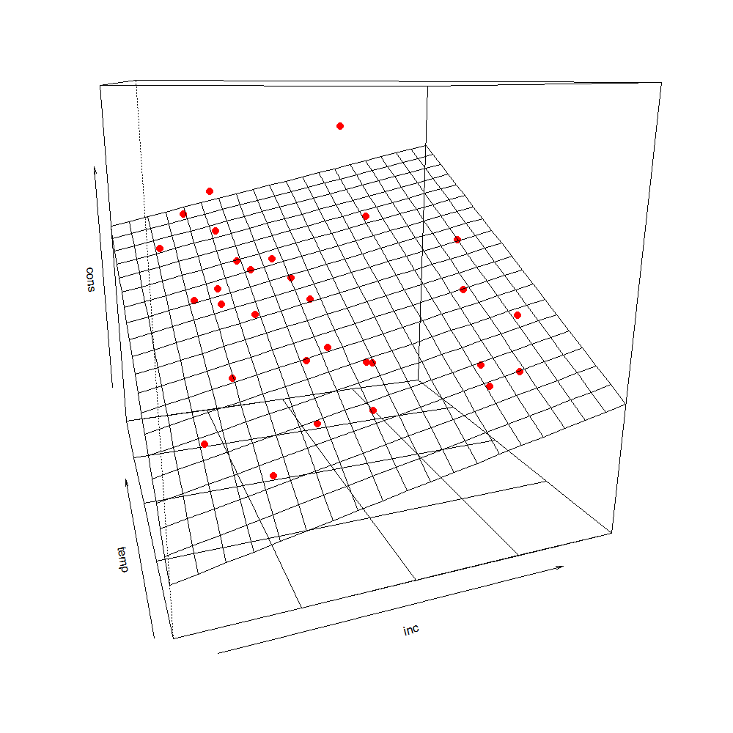
The Output

